Slide 1

Options for obtaining an access token for Microsoft Graph in Azure applications
Microsoft 365 UK User Group June 2021

Slide 2

return(
<div>
<img src=“ ”/>
<Name>Anoop Tatti</Name>
<Work>Content+Cloud</Work>
<Blog link=‘https://anoopt.medium.com’ />
<Twitter username=‘anooptells’ />
<GitHub username=‘anoopt’ />
</div>
)

Slide 3


Microsoft Graph
“Microsoft Graph is the gateway to data and intelligence in Microsoft 365. It provides a unified programmability model that you can use to access the tremendous amount of data in Microsoft 365, Windows 10, and Enterprise Mobility + Security.”
https://docs.microsoft.com/

Slide 4

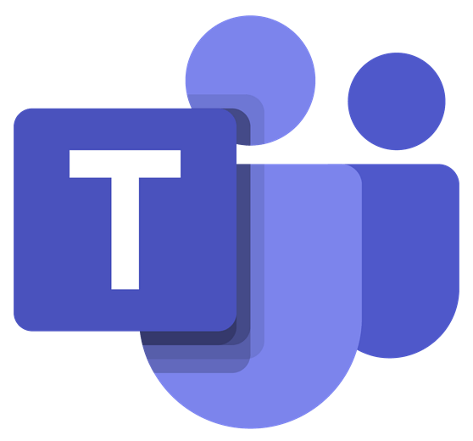



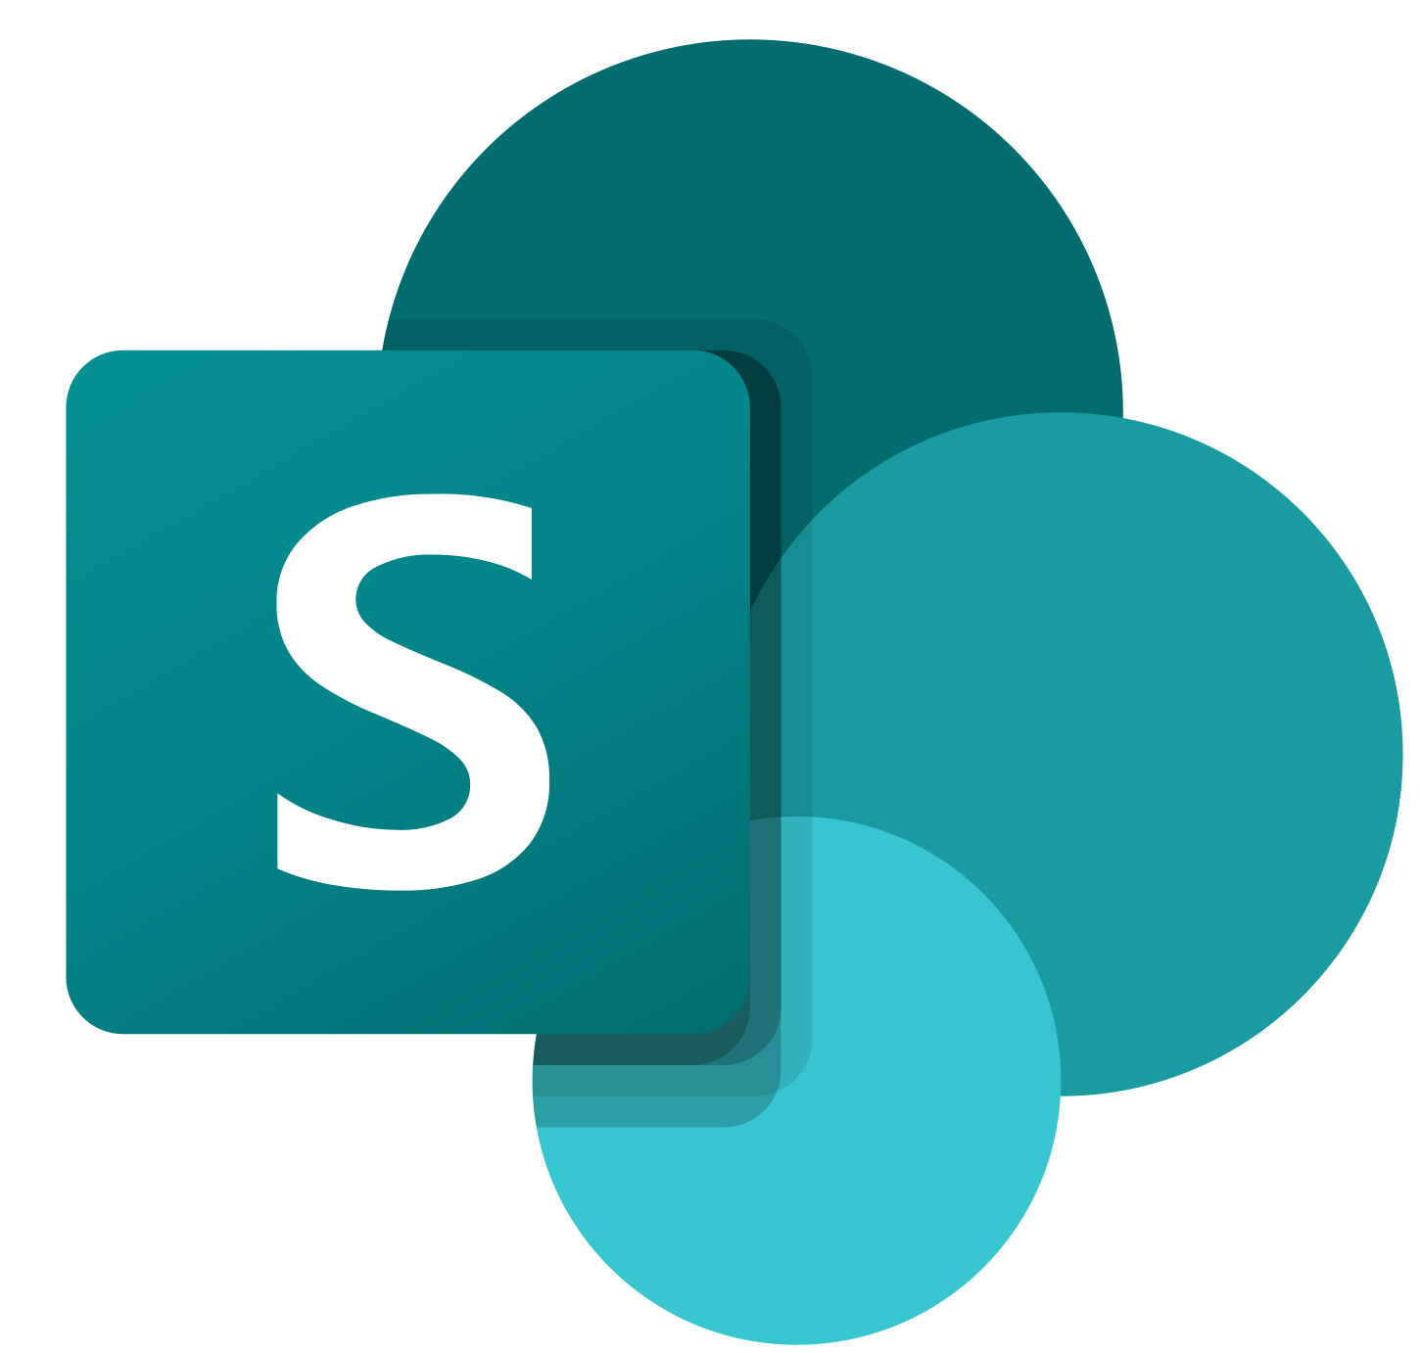

…

Slide 5


Groups.Read
Sites.ReadWrite
…

Slide 6




Azure app sends client id, client secret and scopes to Azure AD
Azure app calls Microsoft Graph using that token
Azure AD does some checks and responds with an access token

Slide 7
Options to get access token
Microsoft have done the hard work
ADAL
Deprecated – support ends next year
MSAL
App authentication library
Use Azure.Identity instead
Azure.Identity

Slide 8
Demo
App registration
Groups.Read.All permission
Azure functions to get groups (Display name)
4 functions
Postman to call Azure function
Logs to see access token
jwt.ms to inspect

Slide 9
Resources
Code - anoopt/m365ukdemo (github.com)
App to app auth
OAuth 2.0 client credentials flow on the Microsoft identity platform | Microsoft Docs
Example of securing a function app

